Slide 1
ILD Endplate Mechanics
Phone meeting June 7, 2012
D. Attié, D. Bachet, P. Colas, P. Manil, M. Riallot

Slide 2
Tool under development
Cathya-based parametrized modelling of an N-wheel endplate. Parameters in an excel-file.
ANSYS mechanical calculation
Iterate and optimize
(see also previous study in 2010 with pressure and weight and hanging efforts, by M. Carty et al.)
Recently the demonstation was made of a fully integrated electronics within 0.25 X0, connected with 3 cables per module (low-voltage, 2mm² copper, high voltage and optical fibre).

Slide 3
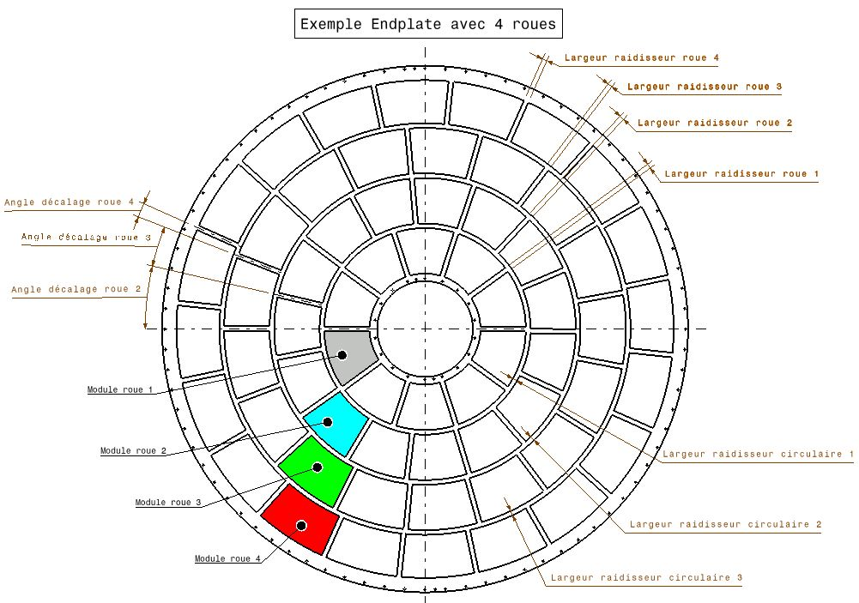
Model parameters
(Rin and Rout are fixed)

Slide 4
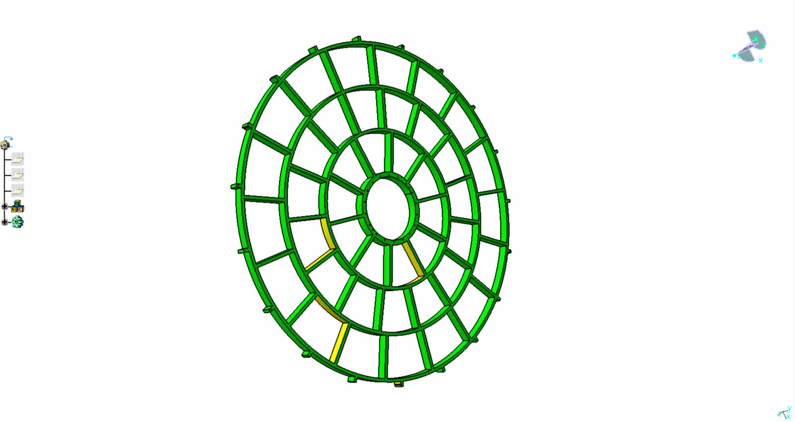
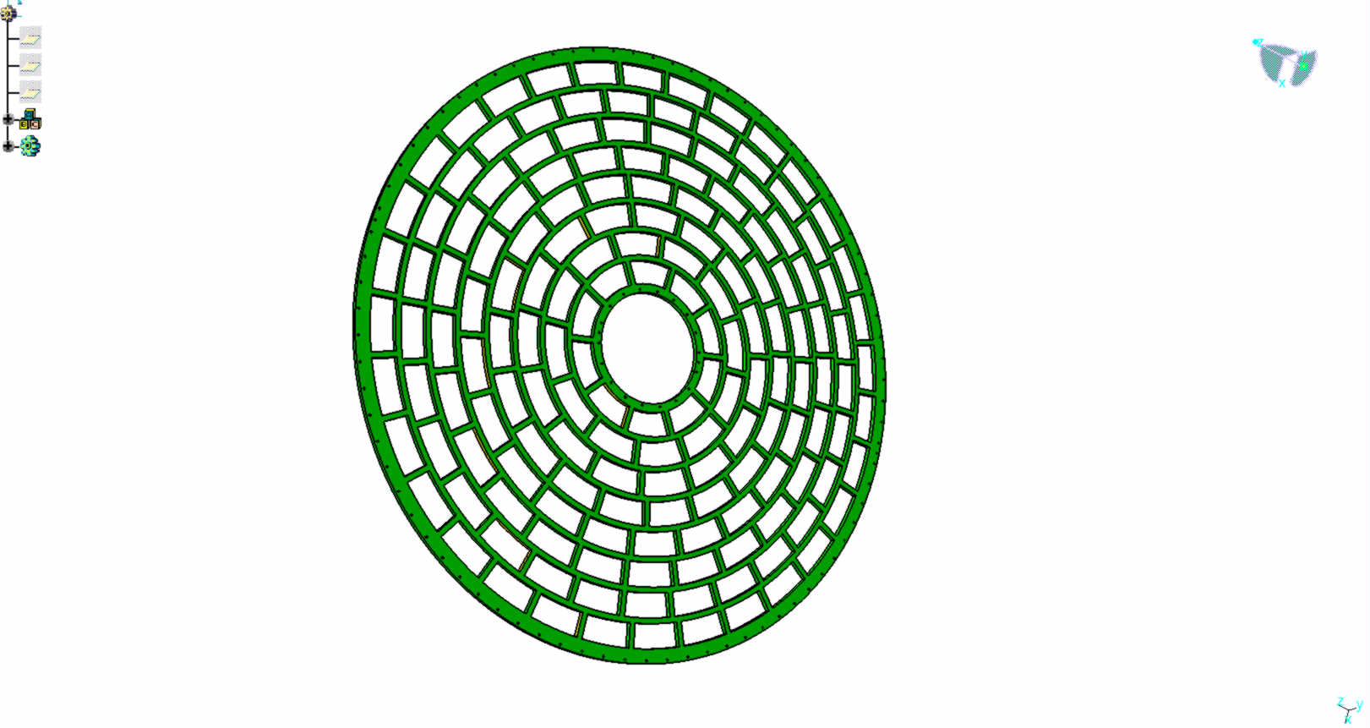
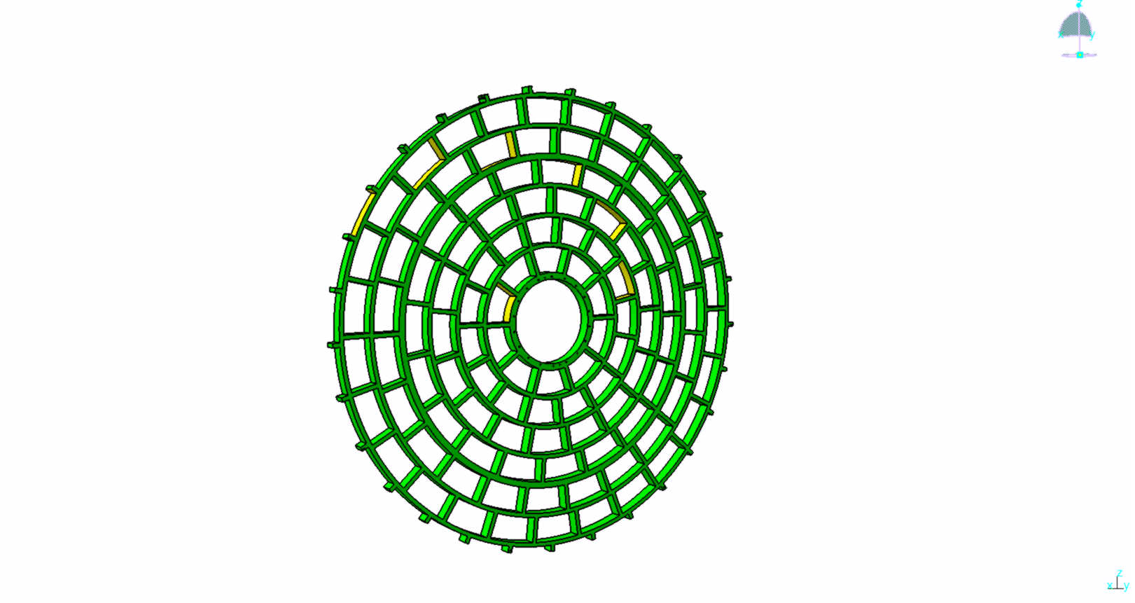
4 wheels
3 wheels
417 kg (Al)
42 modules
680 kg (Al)
61 modules
8 wheels
944 kg (Al)
171 modules
6 wheels
110 modules

